Slide 1

<title> HTML tags
</title>
Presented by Mrunal Anekar

Slide 2

Content
#Structural Tags
#Header Tags
#Breaking Lines and Paragraphs
#Horizontal Rule
#Text Formatting Tags
#Hyperlink Tag
#Dropdown list Tag

Slide 3
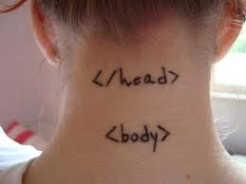

<Title>
#Structural Tags
</Title>
<HTML>
These tags enclose the entire Web page document.
</HTML>
<HEAD>
These tags enclose the Head part of the document
</HEAD>
<TITLE> These tags enclose the title of the document. This text appears in the title
bar in the.
</TITLE>
<BODY>
Body element defines the document’s body.
It contains all the contents of the document (like text, images, colors, graphics, etc.).
</BODY>

Slide 4
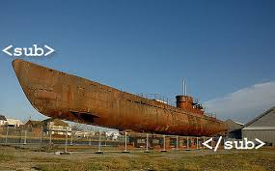

<Title>
#Structural Tags
</Title>
<div> tag defines a division or a section
in an HTML document.
</div>
The <div> element is often used as a container for other HTML elements to style them with CSS or to perform certain tasks with JavaScript.
<sub> tag defines subscript text. Subscript text appears half a character below the normal line, and is sometimes rendered in a smaller font.
</sub>
Subscript text can be used for chemical formulas, like H₂O.

Slide 5
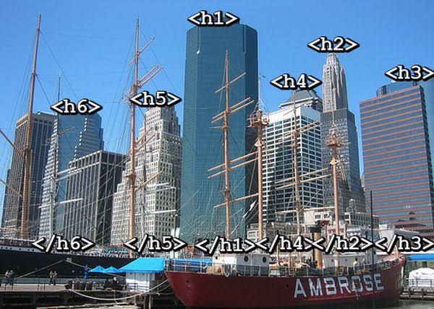
<Title>
#Header Tags
</Title>
Header Tags -- Used for marking sections and
subsections in a document.
<H1>Header 1 -- Giant-sized and bold </H1>
<H2>Header 2 -- Large and bold </H2>
<H3>Header 3 -- Normal-sized and bold </H3>
<H4>Header 4 -- Small and bold </H4>
<H5>Header 5 -- Very Small and bold </H5>
<H6>Header 6 -- Tiny and bold </H6>
H1 = Giant-sized and bold
H2 = Large and bold
H3 = Normal-sized and bold
H4 = Small and bold
H5 = Very Small and bold
H6 = Tiny and bold

Slide 6


<Title>
#Breaking Lines and Paragraphs
</Title>
<P> text </P>
Most browsers render (process) this with blank lines between each paragraph
<BR>
Used when the webmaster wants a carriage return but doesn't want a blank line to follow
&nbsp:
A non-breaking space is a space that will not break into a new line.
Two words separated by a non-breaking space will stick together (not break into a new line).
Example: text a
<p>text a</p>
<p>text b</p> text b
<br>text c
<br>text d text c
text d

Slide 7


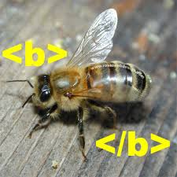
<Title>
#Formatting Tags
</Title>
<I> Italics </I> Italics
<B> Bold </B> Bold
<PRE> Preformatted Text </PRE> Preformatted
<STRONG> Strong </STRONG> Strong
<ADDRESS> Address </ADDRESS> Address
<CITE> Citations </CITE> Citations
<CODE> Source Code </CODE> Source Code
<EM>Emphasized Test</EM> Emphasized text

Slide 8

<Title>
#Hyperlink Tags
</Title>
<a> tag defines a hyperlink, which is used to link from one page to another.
</a>
The most important attribute of the <a> element is the href attribute, which indicates the link's destination.
An unvisited link is underlined and blue
A visited link is underlined and purple
An active link is underlined and red

Slide 9
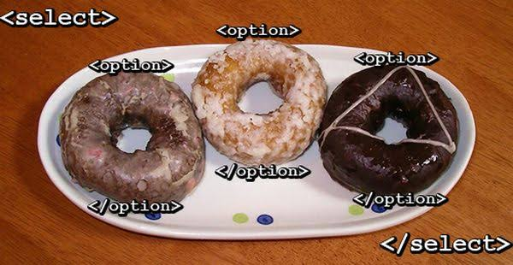
<Title>
#Dropdownlist
</Title>
<select> element is used to create a drop-down list.
</select>
The <option> tags inside the <select> element define the available options in the list.
The <select> element is a form control and can be used in a form to collect user input.

Slide 10
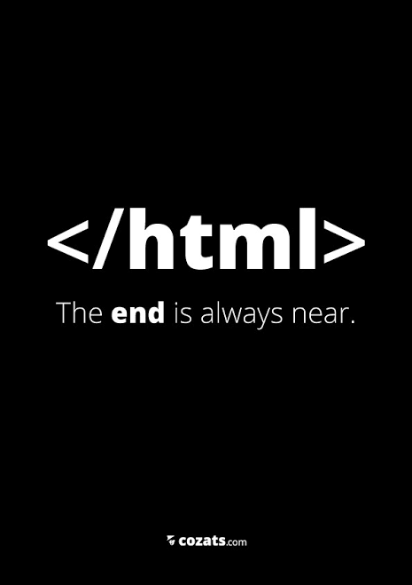
THANK YOU!!
</HTML>

